Slide 1
CSE 2102: Introduction to Software Engineering
Object-Oriented Paradigm
UML, Design Concepts

Slide 2
The Role of Analysis and Design
Software construction may be partitioned into the following phases:
  Requirements analyses
  Software architecture
  Specification (high-level/early design)
  Detailed design
  Implementation and testing
  Maintenance and evolution
Where does OO Analysis and Design fit?

Slide 3
The Role of Analysis and Design
Analysis
  Investigating the boundaries of a problem
  Determining WHAT needs to be done
OO Analysis:
  Emphasis on finding objects and identifying concepts in the problem domain
Design
  Development of a logical solution
  Defining HOW system fulfills WHAT
OO design
  What classes will be necessary to ultimately implement the solution.

Slide 4
The Emergence of UML
The Unified Modeling Language (UML) is the object-oriented analysis and design equivalent of Java
UML is a language for
  Specifying, visualizing, constructing and documenting the artifacts of software
  Web address: http://www.rational.com/uml
UML unifies:
  Object-oriented analysis and design: Grady Booch approach.
  Object-oriented modeling and design: Jim Rumbaugh
  Object-oriented SE, A use case drive approach: Jacobson
A modeling language provides:
  Model elements: Concepts and semantics
  Notation: Visual rendering of model elements
  Guidelines: Hints and suggestions for using elements in notation

Slide 5
Seven Goals of UML
Ready-to-use, expressive visual modeling language that promotes development/exchange
Extensibility/specialization of core concepts
Independent of programming languages and development processes
Formal basis for understanding language
Encourage growth of OO tools market
Support higher level design concepts
  Collaborations, frameworks, patterns, etc.
Integrate the best practices of all OOD

Slide 6
Characteristics of UML
Generic syntax for creating a logical model of the system
Syntax is independent of:
  Any particular target language
  Software process
  Software tool
Syntax is flexible and can be customized by user-defined extensions to accommodate any process, tool, and language

Slide 7
Uses of UML
As a sketch: To communicate aspects of the system:
  Forward design: doing UML before coding
  Backward design: doing UML after coding as documentation
  Often done on whiteboard or paper
  Used to get rough selective ideas
As a blueprint: a complete design to be implemented:
  Sometimes done with CASE (Computer-Aided Software Engineering) tools
As a programming language: with the right tools, code can be auto-generated and executed from UML
  Only good if this is faster than coding in a "real" language

Slide 8
UML Modeling Constructs/Diagrams
User interaction diagrams
  Use-case diagrams
Static structure diagrams
  Class diagrams
  Object diagrams
Behavior diagrams
  Statechart diagrams
  Activity diagrams
Interaction diagrams
  Sequence diagram
  Collaboration diagram
Implementation diagrams
  Component diagram
  Deployment diagram

Slide 9
Class Diagrams
  UML class diagram: a picture of the classes in an OO system, their fields and methods, and connections between the classes that interact or inherit from each other
Classes are graphically represented as boxes with compartments for:
  Class name, private attributes, and public operations
  Properties, responsibilities, rules, modification history, etc.
Designer develops classes as sets of compartments that grow over time to incrementally add functionality and features
Some things that are not represented in a UML class diagram?
  Details of how the classes interact with each other
  Algorithmic details; how a particular behavior is implemented

Slide 10
Diagram of One Class
Class name in top of box
  Write <<interface>> on top of interfaces' names
  Use italics for an abstract class name
Attributes (optional)
  Should include all fields of the object
Operations / methods (optional)
  May omit trivial (get/set) methods
    but don't omit any methods from an interface!
  Should not include inherited methods
Name
CustomerAccount
+ Account: Int
+ Name: String
+ Address: String
+ Balance: Float
totalCust: Int
Attributes
+ AddCustomer()
+ DeleteCustomer()
+ GetBalance()
Operations

Slide 11
Diagram of One Class (contd..)
Attributes (fields, instance variables)
  visibility name : type [count] =
  default_value
  visibility: + public
  # protected
  - private
  ~ package (default)
  / derived
  underline static attributes
  Derived attribute: not stored, but can be computed from other attribute values
  Attribute example:
  - balance : double = 0.00
CustomerAccount
Name
+ Account: Int
+ Name: String
+ Address: String
+ Balance: Float
totalCust: Int
Attributes
+ AddCustomer()
+ DeleteCustomer()
+ GetBalance()
Operations

Slide 12
Diagram of One Class (contd..)
operations / methods
  visibility name (parameters) :
  return_type
  visibility: + public
  # protected
  - private
  ~ package (default)
  underline static methods
  parameter types listed as (name: type)
  omit return_type on constructors and
  when return type is void
  method example:
  + distance(p1: Point, p2: Point): double
Customer
Name
+ Account: Int
+ Name: String
+ Address: String
+ Balance: Float
totalCust: Int
Attributes
+ AddCustomer()
+ DeleteCustomer()
+ GetBalance()
Operations

Slide 13
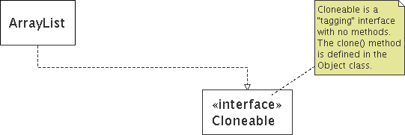
Comments
Represented as a folded note, attached to the appropriate class/method/etc by a dashed line

Slide 14
Relationships Among Classes
Generalization: an inheritance relationship
  Inheritance between classes
  Interface implementation
Association: a usage relationship
  Dependency
  Aggregation
  Composition

Slide 15
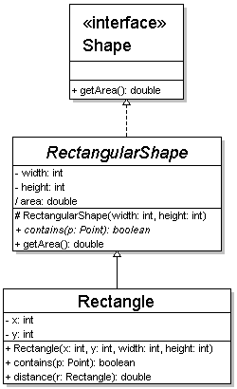
Generalization Relationships
Generalization (inheritance) relationships
  hierarchies drawn top-down with arrows pointing upward to parent
  line/arrow styles differ, based on what the parent is:
    class:
    solid line, black arrow
    abstract class:
    solid line, white arrow
    interface:
    dashed line, white arrow

Slide 16
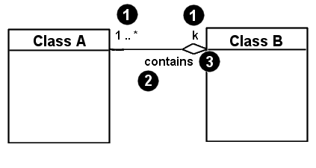
Associational Relationships
associational (usage) relationships
  1. multiplicity (how many are used)
    * ⇒ 0, 1, or more
    1 ⇒ 1 exactly
    2..4 ⇒ between 2 and 4, inclusive
    3..* ⇒ 3 or more
  2. name (what relationship the objects have)
  3. navigability (direction)

Slide 17
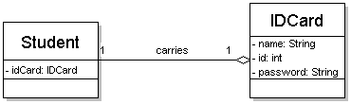
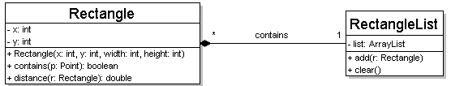
Multiplicity of Associations
One-to-one
  Each student must carry exactly one ID card
One-to-many
  One rectangle list can contain zero or more rectangles
1 1

Slide 18
Association Types
Aggregation: "is part of"
  symbolized by a clear white diamond
Composition: "is entirely made of"
  stronger version of aggregation
  the parts live and die with the whole
  symbolized by a black diamond
Car
1
1
aggregation
Engine
Book
composition
1
*
Page

Slide 19
Association types (contd..)
Dependency: "uses temporarily"
  Symbolized by dotted line
  Often is an implementation
  detail, not an intrinsic part of
  that object's state
dependency
Lottery
Ticket
Random

Slide 20
Guidelines for Designing Classes
Specifying “Good” Classes
Identifying a good class is hard work
A well-defined class is:
  Highly cohesive: A single design abstraction
  Promotes loose coupling: Minimal ties to other classes
  Sufficient: Captures “enough” characteristics for efficient and meaningful operation
  Complete: Characteristics provide wide range of useful capabilities for clients
  Primitive: Operations are implementable when given access to hidden data of class
  Non-redundant: No two classes same
  Predictable: Behaves as expected by the users.

Slide 21
Guidelines for Designing Classes (contd.)
Containment vs. inheritance
  Class D “Has-A” class C (Containment)
    Class D has an attribute of type class C
    Instances of class C live within class D
  Class D “Is-A-Kind-Of” class C
    Class D needs to acquire all behavior of class C (Inheritance)
    Class D is a specialization of class C
Choose
  Inheritance if class D is used by other classes
  Containment if class C is dedicated to class A
Designers must cooperate and communicate

